Slide 1
Loan Default Prediction
Saeed Rafieepour

Slide 2


The problem
Lending Club used to be the largest peer to peer lending platform until 2020.
Investor
Allowable loan range between $1,000–40,000
return period 3 or 5 years
from interest rates varied from 6% to 35%.
Borrower
Lending Club assign a loan grade, loan amount, and interest rate.
An origination fee is applied: 1.1-5% of loan amount.
If interest fee is high, then loan is RISKY!
Factors: Credit score, credit history, desired loan amount and the debt-to-income ratio, etc.
What factors affect the loan default?
Can we predict if a borrower defaults based on the information at the time of application?

Slide 3
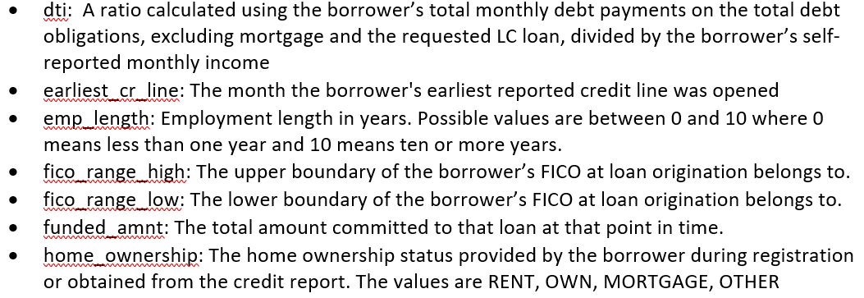
Data Source
The dataset used for this project is from Kaggle!
Dataset has 2,260,701 observations of loans granted between 2007 to 2018.
Dataset has 151 features including information about applicants such as credit score, income, and employment, as well as data about loans, such as their amounts, and terms.
Data is in CSV format.

Slide 4
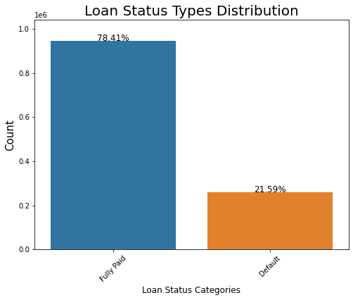
Data Wrangling
Any feature that is not defined prior to the decision on the loan application is dropped.
General features such as member identification numbers or url that do not provide meaningful information are also dropped.
Any column with 70% missing values are dropped.
The loans in the dataset are in 5 categories: Current, Fully paid, Charged-off, Default and Late. The current loans are dropped. The charged-off and Default categories are combined in one category and is called Default
Imbalanced dataset!

Slide 5
Exploring effects of various factors on fully-paid and default status
Length of employment, as well as home ownership is not a great predictor of fate of a loan
Applicants with higher credit scores are also better borrowers.
Previous charged off accounts or bankruptcies in an applicant's credit history or the length of the applicant's credit history do not affect how one performs on their loan return.
Applicant's balance and their utilization rate do not affect how they will return the loan. While the number of credits an applicant owns is not a determinant in the fate of a loan, applicants with more mortgages tend to perform better.
More installment will results in higher probability of a loan defaulting.
Higher interest rates also result in higher chance of default. Also, while 30% of loans with 30 months return period default, this value doubles for loans with 60 months return period.
DTI, debt-to-income ratio is a good predictor of default

Slide 6
Exploring effects of various factors on fully-paid and default status
There are 35 grades for loans starting from A1 and ending in G5. Briefly, as a loan moves from A1 to G5, the riskier the loan will be. It is clear from data analysis that as loan grade decreases from A1 to G5, the probability of defaulting increases; while less than 10% of grade-A loans default, there is about 50% probability that a G-grade loan defaults. So, grade can be a strong predictor of if a loan defaults.
Applicants’ place of living does not affect in their loan performance.
Principle component analysis on the numerical features also showed that, loan amount, dti, Fico scores and revolving balance are important in the first 2 principle components. Only about 32% of the variance is explained by the first two components.
We should note that, installment and interest rate, as well as subgrade are features determined by the lending club based on an application.

Slide 7
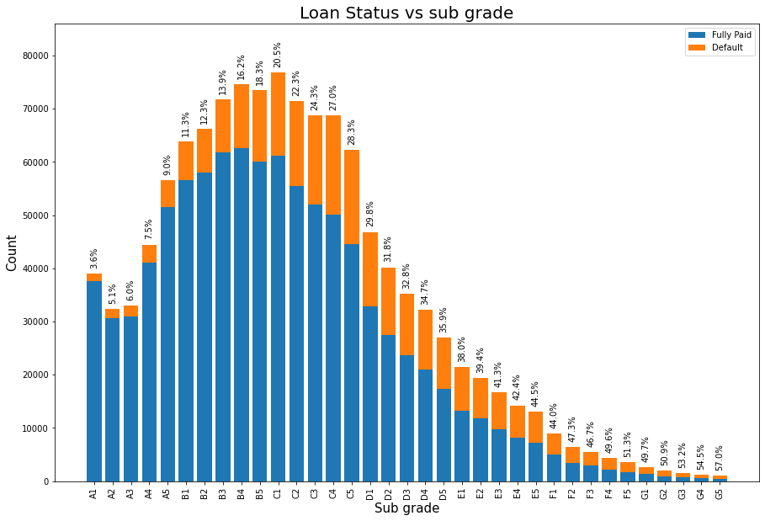
Loan status distribution vs grade

Slide 8
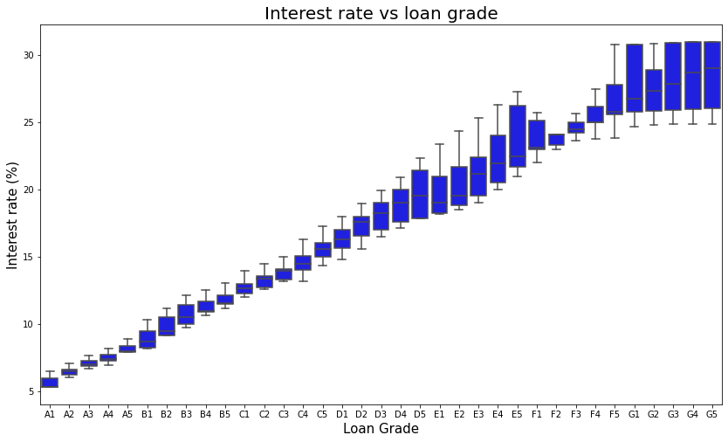
Loan status distribution vs grade

Slide 9
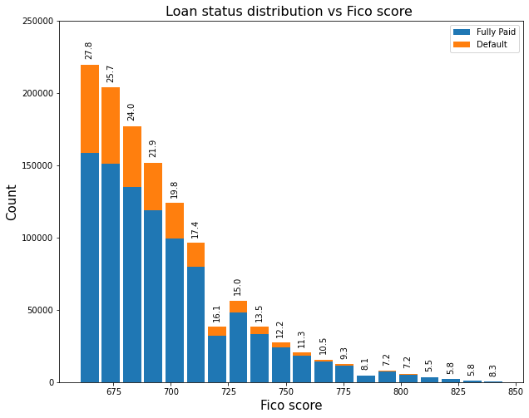
Loan status vs Fico score

Slide 10
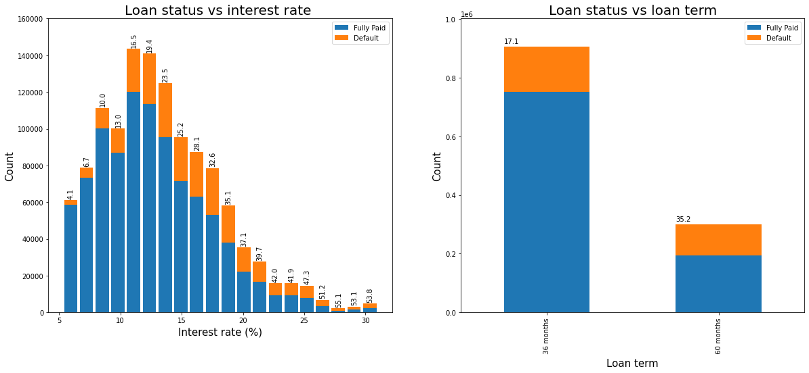
Loan status distribution vs interest rate and loan term

Slide 11
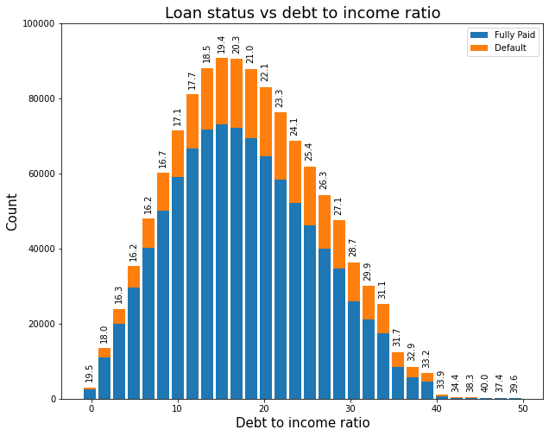
Debt to income ratio

Slide 12
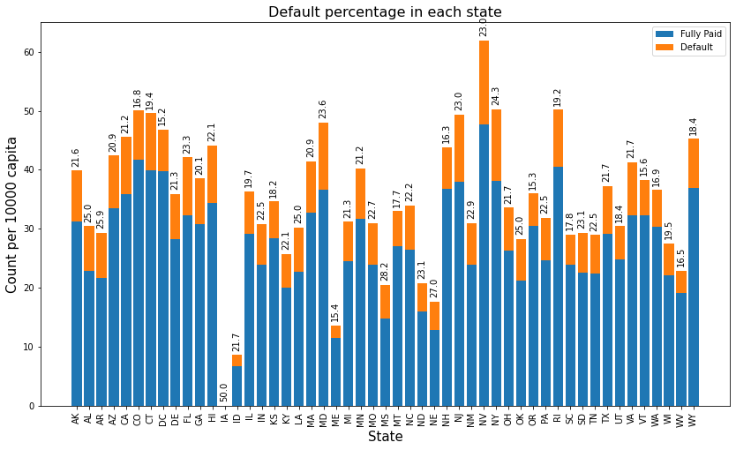
Does the applicant's residential state affect their performance?

Slide 13
Model training
Four classifiers used are: Logistic regression, Decision tree Classifier, Random Forest, and Gradient boosting.
As only 22% of the loans are in default category, the dataset is imbalanced, and thus an undersampling was applied.
In each model training, a pipeline including scaling and modeling steps was created and by using GridSearchCV, hyperparameters were tuned, followed by feature importance analysis.
 | Logistic Regression | Decision Tree | Random Forest | XGBoost
Mean | 0.6533 | 0.6481 | 0.6532 | 0.6627
Standard Deviation | .0012 | 0.0019 | 0.0018 | 0.0007

Slide 14
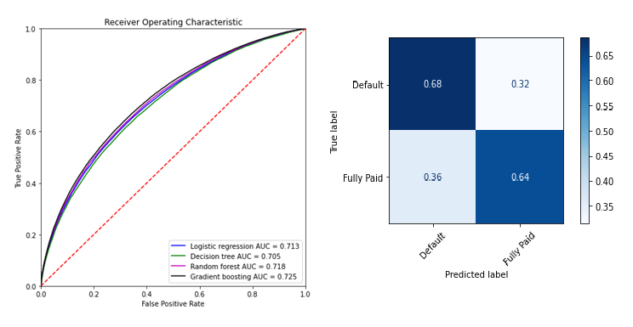
Selecting the classifier

Slide 15
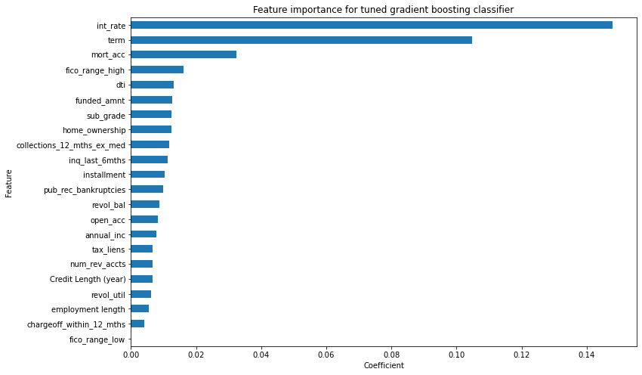
Feature importance analysis

